Slide 1
XAI-Guided Interventional Retraining for Domain Adaptation Final Report
QIU Yaowen, yqiuau @ connect.ust.hk

Slide 2
Background & Objective
Problem: Models trained in one domain usually do not perform well in other domains.
Models pay attention on wrong objects, such as grassland (background) behind the cow (ground truth).
Idea: (1) regular training (2) interventional retraining (IR)
Purpose : Reduce the impact of background

Slide 3

Dataset - ImageNet
1000 Categories
1.28 M Training Images + 50,000 Validation Images

Slide 4
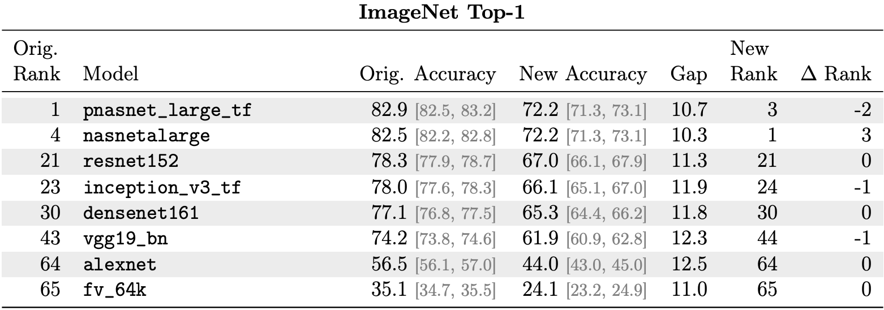
Dataset – ImageNetv2
10,000 Validation Images
Generated To measure the generation ability of the models
A huge drop of Top-1 Accuracy happens in all models

Slide 5
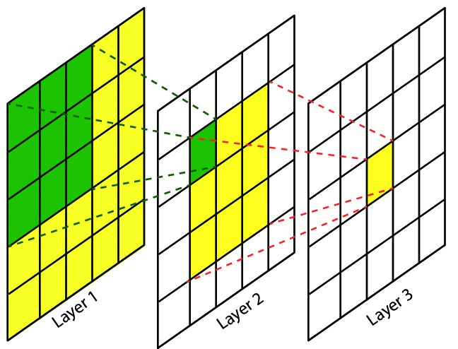
Framework
Trough Logit W
regular training phase
X_{i}
H_{i}
y_{i}
Image Example
Gradient
Gradient
Feature Mapping
Feature Map
Probability Vector
Trough Logit W’
X_{i}’
H_{i}’
y_{i}
interventional retraining phase
Image with object of interest only
Gradient
Fixed Feature Mapping
Modified Feature Map
Probability Vector

Slide 6
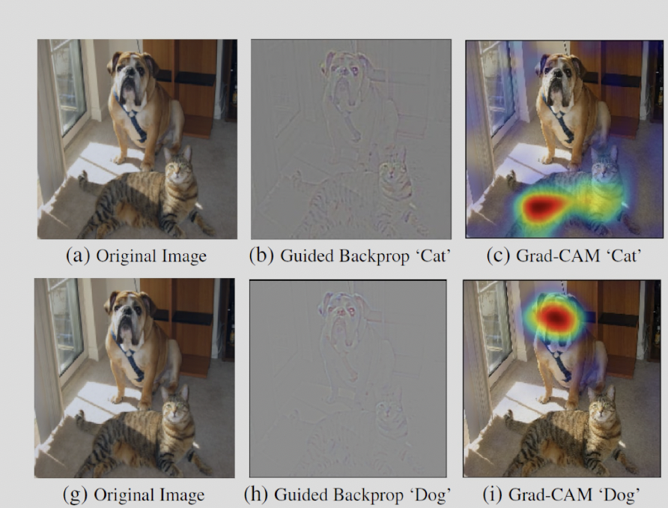
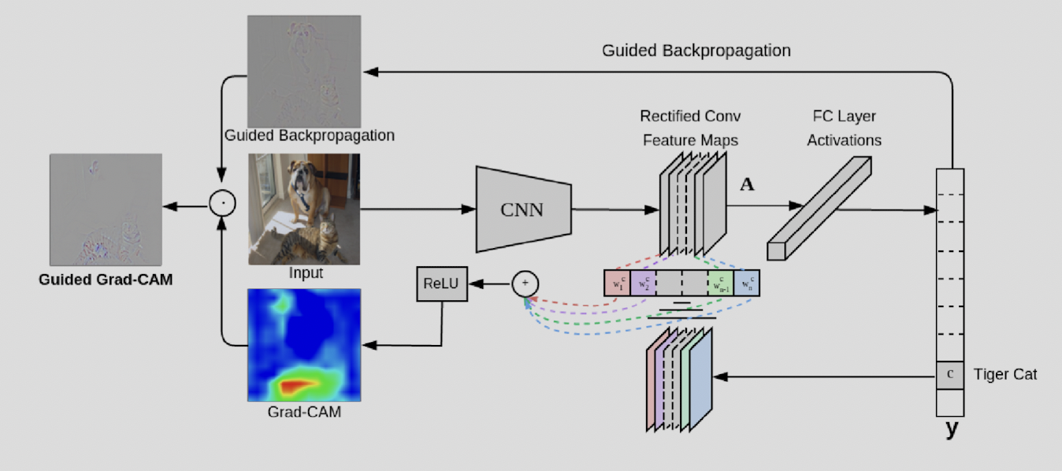
Use Grad-CAM to compute class attention heatmap
Gradient-weighted Class Activation Mapping(Grad-CAM):
Class discriminative
Localize True Label objects in the images

Slide 7
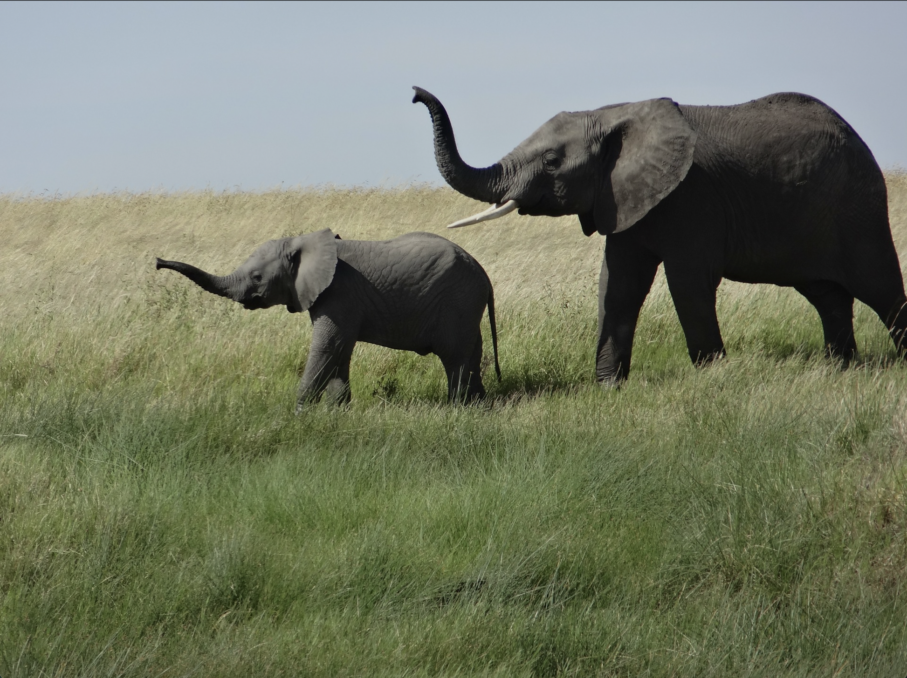
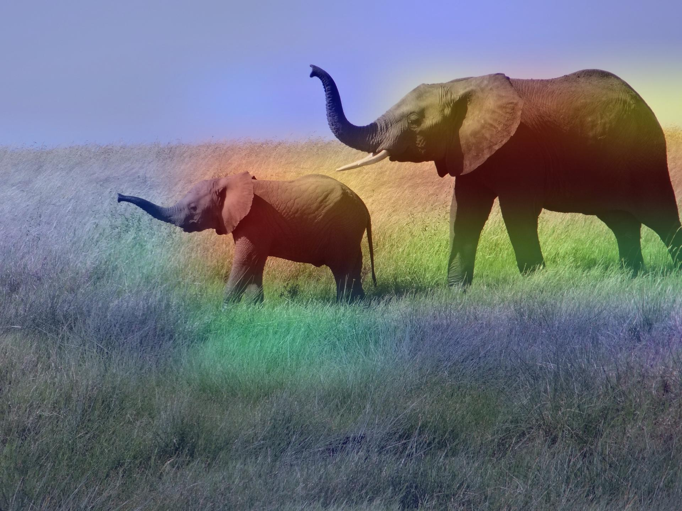
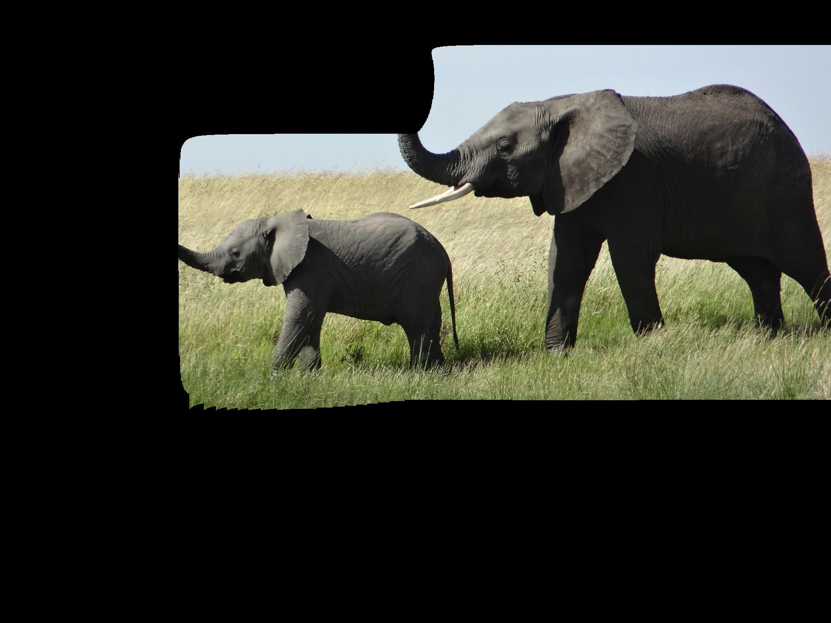
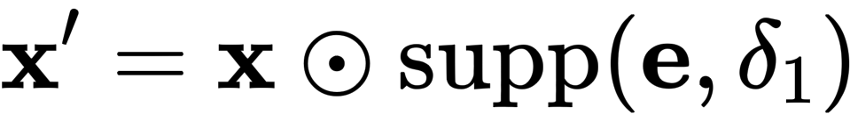
Use Grad-CAM to compute class attention heatmap
X : African Elephant
e : Grad-CAM
Remove the Background
δ1 = 0.01

Slide 8
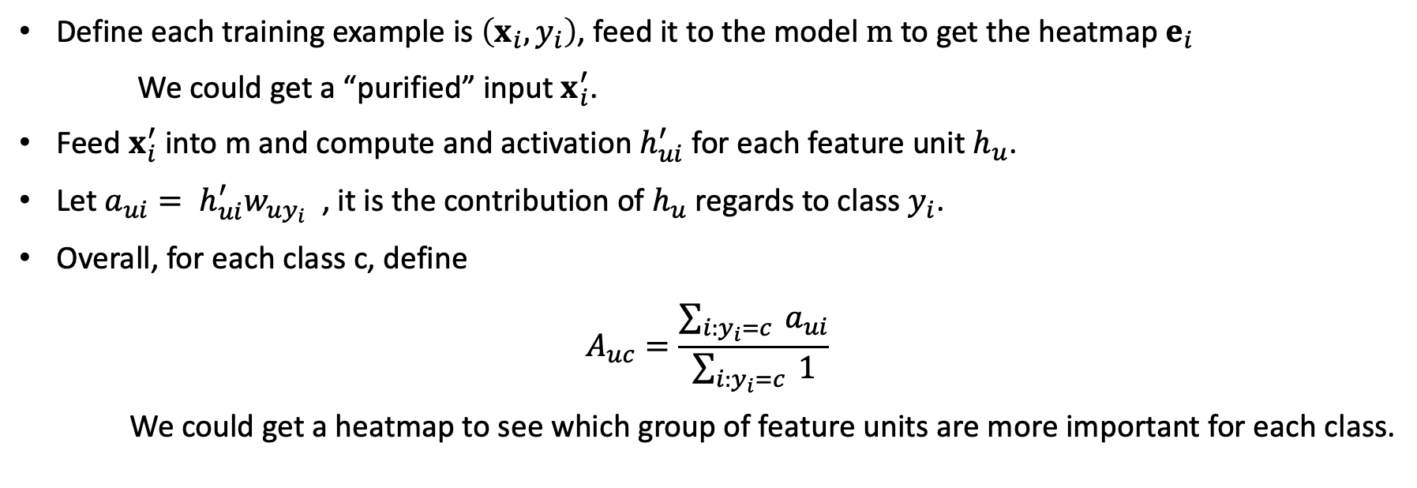
The importance of feature units are different
Define each training example is $\left(x_{i},y_{i}\right)$, feed it to the model$m$ to get the heatmap $e_{i}$
We could get a “purified” input $x_{i}^{′}$.
Feed $x_{i}^{′}$ into m and compute and activation $h_{ui}^{′}$ for each feature unit $h_{u}$.
Let $a_{ui}= h_{ui}^{′}w_{uy_{i}}$ , it is the contribution of $h_{u}$ regards to class $y_{i}$.
Overall, for each class c, define
$$A_{uc}=\frac{\sum_{i:y_{i}=c}{ }a_{ui}}{\sum_{i:y_{i}=c}{ }1}$$
We could get a heatmap to see which group of feature units are more important for each class.

Slide 9
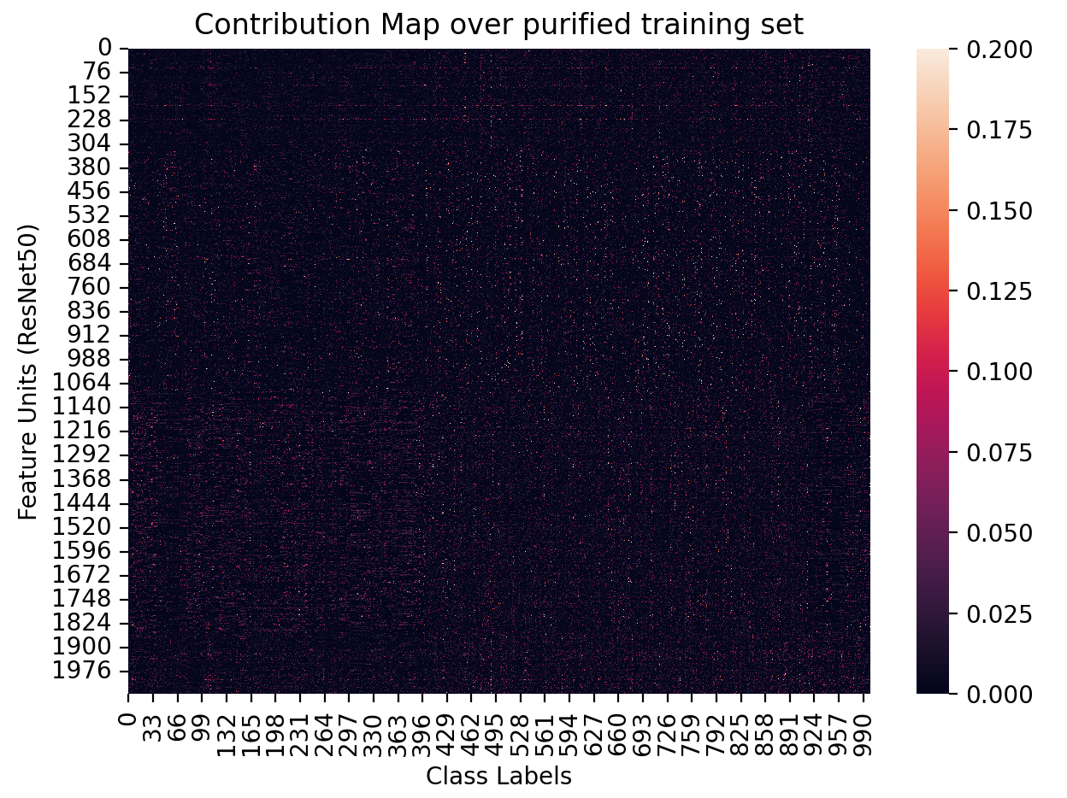
Visualization of Features Contribution over Classes
We can observe that:
For each class, indeed some feature units are more important
The set of important feature units are varied across all classes
3. Some feature units are more likely to be important

Slide 10
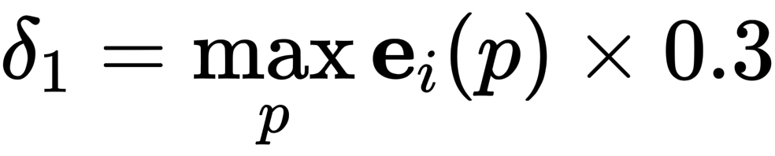
Version 0: Completely follow original idea
Use all training examples
Reinitialize the parameters in the last layer
Retrain the model only on purified examples

Slide 11
Version 0: Completely follow original idea
Training Setting:
Baseline:ResNet50
EPOCHS = 5
LEARNING RATE = 1e-4, ADAM

Slide 12
Version 0: Completely follow original idea
Model | Val Top-1 Acc | Val Top-5 Acc | V2 Top-1 Acc | V2 Top-5 Acc | Top-1 Gap | Top-5 Gap
ResNet50 | 75.67% | 92.44% | 63.01% | 84.14% | 12.66% | 8.30%
ResNet50 (v0) | 75.03% (-0.64%) | 92.01% (-0.43%) | 62.99% (-0.02%) | 84.01% (-0.13%) | 12.04% (-0.62%) | 8.00% (-0.30%)
Both Accuracy on validation set and imagenetv2 drops
The Accuracy gap decreases.

Slide 13
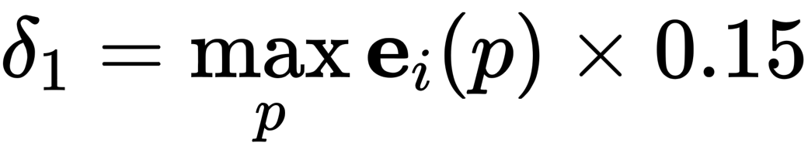
Version 1: Use “Purified training set”
Compute New Training Set:
Use Perplexity to filter pure examples
Define the C-perplexity percentile = 20% as threshold
Define the X-perplexity threshold = 0.3
No Union Training, only used examples from (1)
Generate examples with no background using Gradcam and

Slide 14
Version 1: Use “Purified training set”
Training Setting:
Baseline:ResNet50
EPOCHS = 6
LEARNING RATE = 1e-4, ADAM

Slide 15
Version 1: Use “Purified training set”
Model | Val Top-1 Acc | Val Top-5 Acc | V2 Top-1 Acc | V2 Top-5 Acc | Top-1 Gap | Top-5 Gap
ResNet50 | 75.67% | 92.44% | 63.01% | 84.14% | 12.66% | 8.30%
ResNet50 (v1) | 74.89% (-0.78%) | 91.57% (-0.87%) | 62.55% (-0.46%) | 84.01% (-0.13%) | 12.34% (-0.32%) | 7.56% (-0.74%)
ResNet50 (v0) | 75.03% (-0.64%) | 92.01% (-0.43%) | 62.99% (-0.02%) | 84.01% (-0.13%) | 12.04% (-0.62%) | 8.00% (-0.30%)
Both Accuracy on validation set and imagenetv2 drops
The Accuracy gap decreases.
Observed that bias distribution of v1 is very different from baseline’s

Slide 16
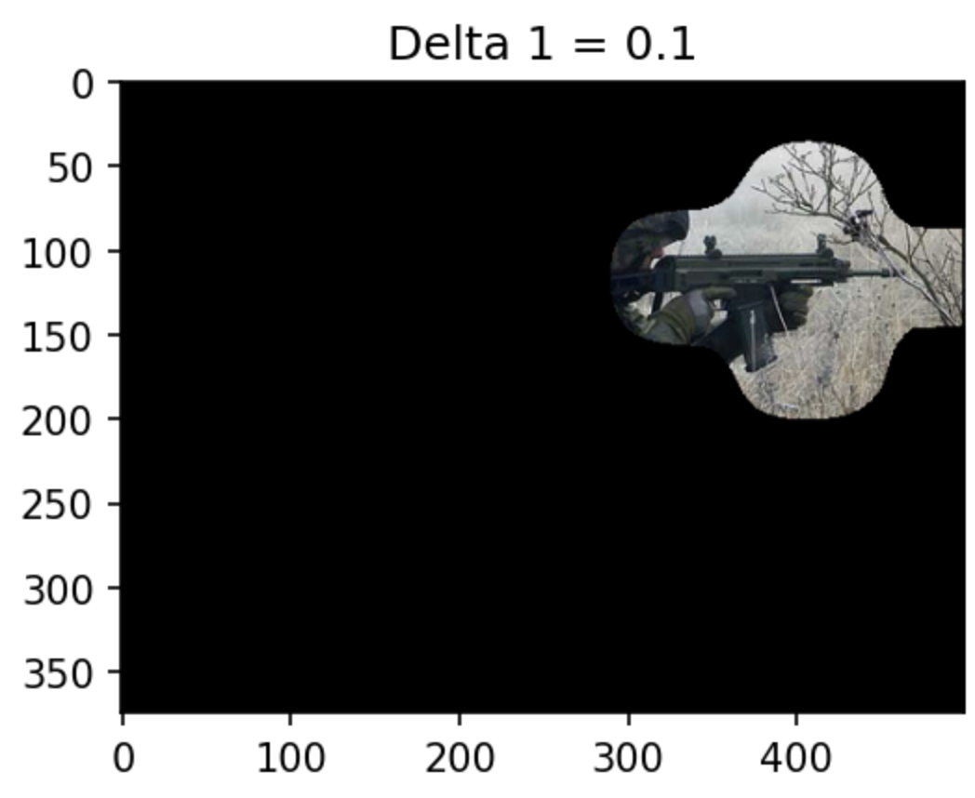
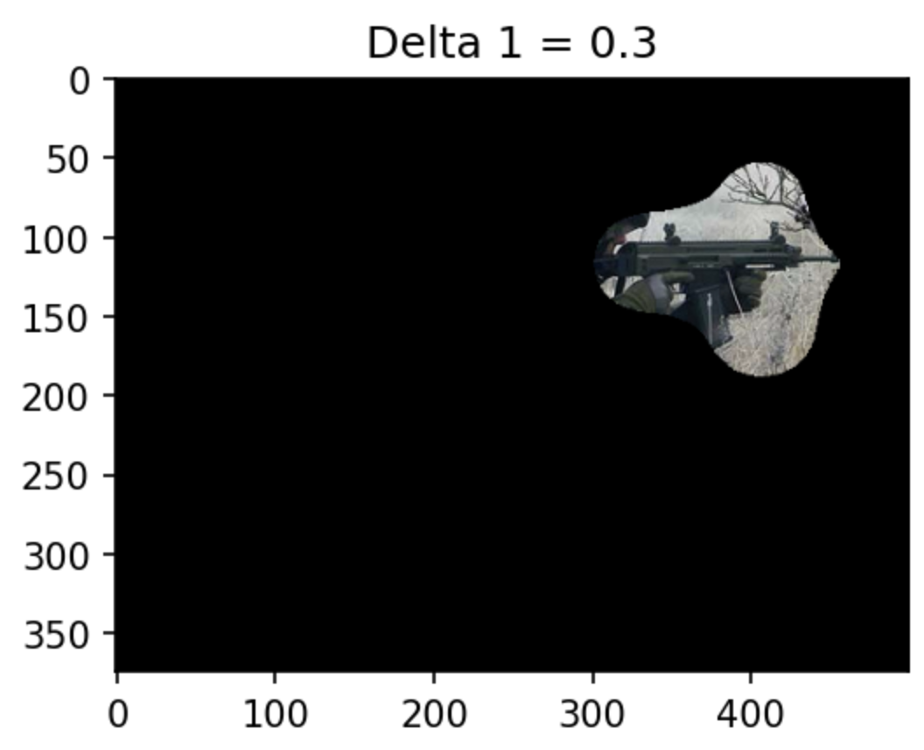
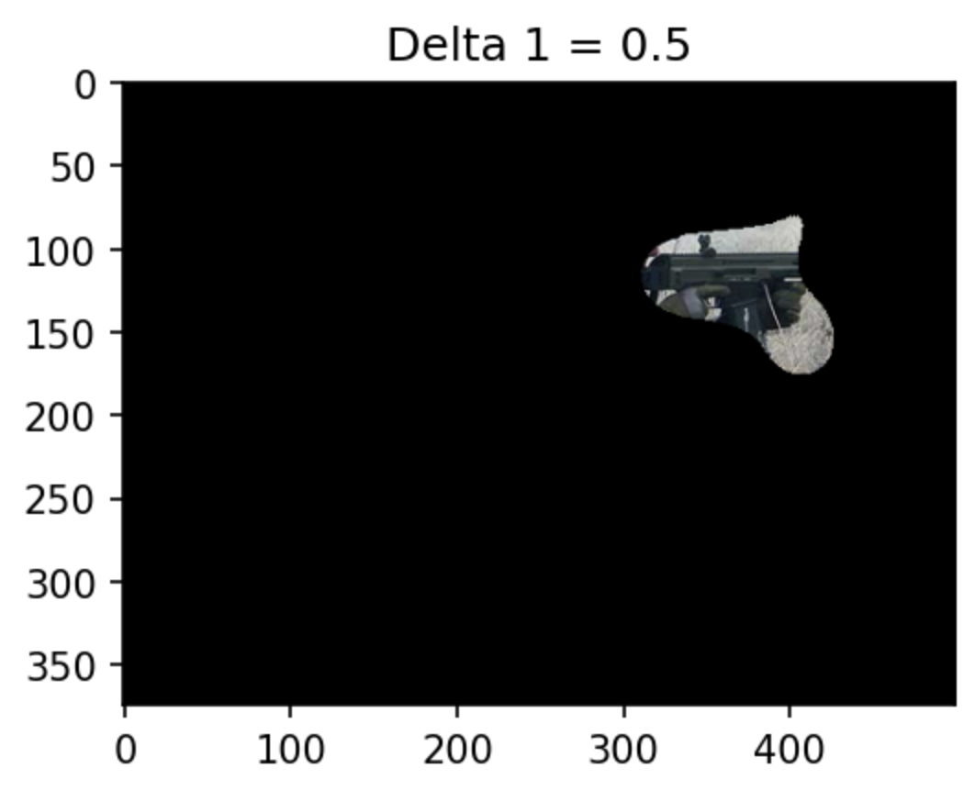
Version 1: Problems
Small delta1 fails to locate the ground truth object precisely.
Apply filter to the whole training set leads to unbalance distribution among labels
The distribution of bias changed a lot, which is not ideal

Slide 17
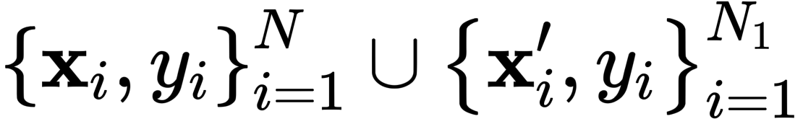
Version 2: Fix some problems based on v1
Compute New Training Set:
Use C-Perplexity only to filter pure examples for each class
Define the C-perplexity percentile = 20% as threshold
Maintain Class balance
Union Training, x_newtrain =
Generate examples with no background using Gradcam and

Slide 18
Version 2: Fix some problems based on v1
Training Setting:
EPOCHS = 10
LEARNING RATE = 1e-4, ADAM
Adopt weight decay on W & b
No intervention to change feature values

Slide 19
Version 2: Fix some problems based on v1
Model | Val Top-1 Acc | Val Top-5 Acc | V2 Top-1 Acc | V2 Top-5 Acc | Top-1 Gap | Top-5 Gap
ResNet50 | 75.67% | 92.44% | 63.01% | 84.14% | 12.66% | 8.30%
ResNet50 (v1) | 74.89% (-0.78%) | 91.57% (-0.87%) | 62.55% (-0.46%) | 84.01% (-0.13%) | 12.34% (-0.32%) | 7.56% (-0.74%)
ResNet50 (v2) | 75.76% (+0.11%) | 92.59% (+0.13%) | 62.98% (-0.03%) | 84.13% (-0.01%) | 12.78% (+0.12%) | 8.46% (+0.16%)
ResNet50 (v0) | 75.03% (-0.64%) | 92.01% (-0.43%) | 62.99% (-0.02%) | 84.01% (-0.13%) | 12.04% (-0.62%) | 8.00% (-0.30%)
Accuracy on validation set and imagenet-v2 are significantly better than v1
But the gap is even worse than baseline
The distribution of v1’s weight & bias become similar to baseline’s

Slide 20
Version 3: Adopt different baseline based on v2
Baseline Model : Inceptionv3
It is hoped that it can generate more reliable Gradcam
1. Use this baseline model to Generate Grad-CAM Images
2. Then adopt version 2 XGIR again
3. Train the baseline model using full ImageNet for 5 epochs, then adopt version 2 XGIR

Slide 21
Version 3: Adopt different baseline based on v2
Model | Val Top-1 Acc | Val Top-5 Acc | V2 Top-1 Acc | V2 Top-5 Acc | Top-1 Gap | Top-5 Gap
ResNet50 | 75.67% | 92.44% | 63.01% | 84.14% | 12.66% | 8.30%
ResNet50 (v1) | 74.89% (-0.78%) | 91.57% (-0.87%) | 62.55% (-0.46%) | 84.01% (-0.13%) | 12.34% (-0.32%) | 7.56% (-0.74%)
ResNet50 (v2) | 75.76% (+0.11%) | 92.59% (+0.13%) | 62.98% (-0.03%) | 84.13% (-0.01%) | 12.78% (+0.12%) | 8.46% (+0.16%)
Training on Full ImageNet will increase accuracy on both the validation sets, and increases gap.
It looks like that current XGIR tends to increase the accuracy on validation set only, but not Imagenetv2.
And instead larger the gap.
ResNet50 (v0) | 75.03% (-0.64%) | 92.01% (-0.43%) | 62.99% (-0.02%) | 84.01% (-0.13%) | 12.04% (-0.62%) | 8.00% (-0.30%)
Model | Val Top-1 Acc | Val Top-5 Acc | V2 Top-1 Acc | V2 Top-5 Acc | Top-1 Gap | Top-5 Gap
Inceptionv3 | 77.90% | 93.70% | 63.87% | 85.17% | 14.03% | 8.53%
Inceptionv3-epoch 5 | 78.15% (+0.25%) | 94.10% (+0.40%) | 63.90% (+0.03%) | 85.19% (+0.02%) | 14.25% (+0.22%) | 8.91% (+0.38%)
Inceptionv3 (v3) | 78.10% (+0.20%) | 93.98% (+0.28%) | 63.79% (-0.08%) | 85.12% (-0.05%) | 14.31% (+0.28%) | 8.86% (+0.33%)
Inceptionv3-epoch 5 (v3) | 78.19% （+0.29%） | 94.13% （+0.43%） | 63.87% （+0.00%） | 85.18% （+0.01%） | 14.32% （+0.29%） | 8.92% （+0.39%）

Slide 22
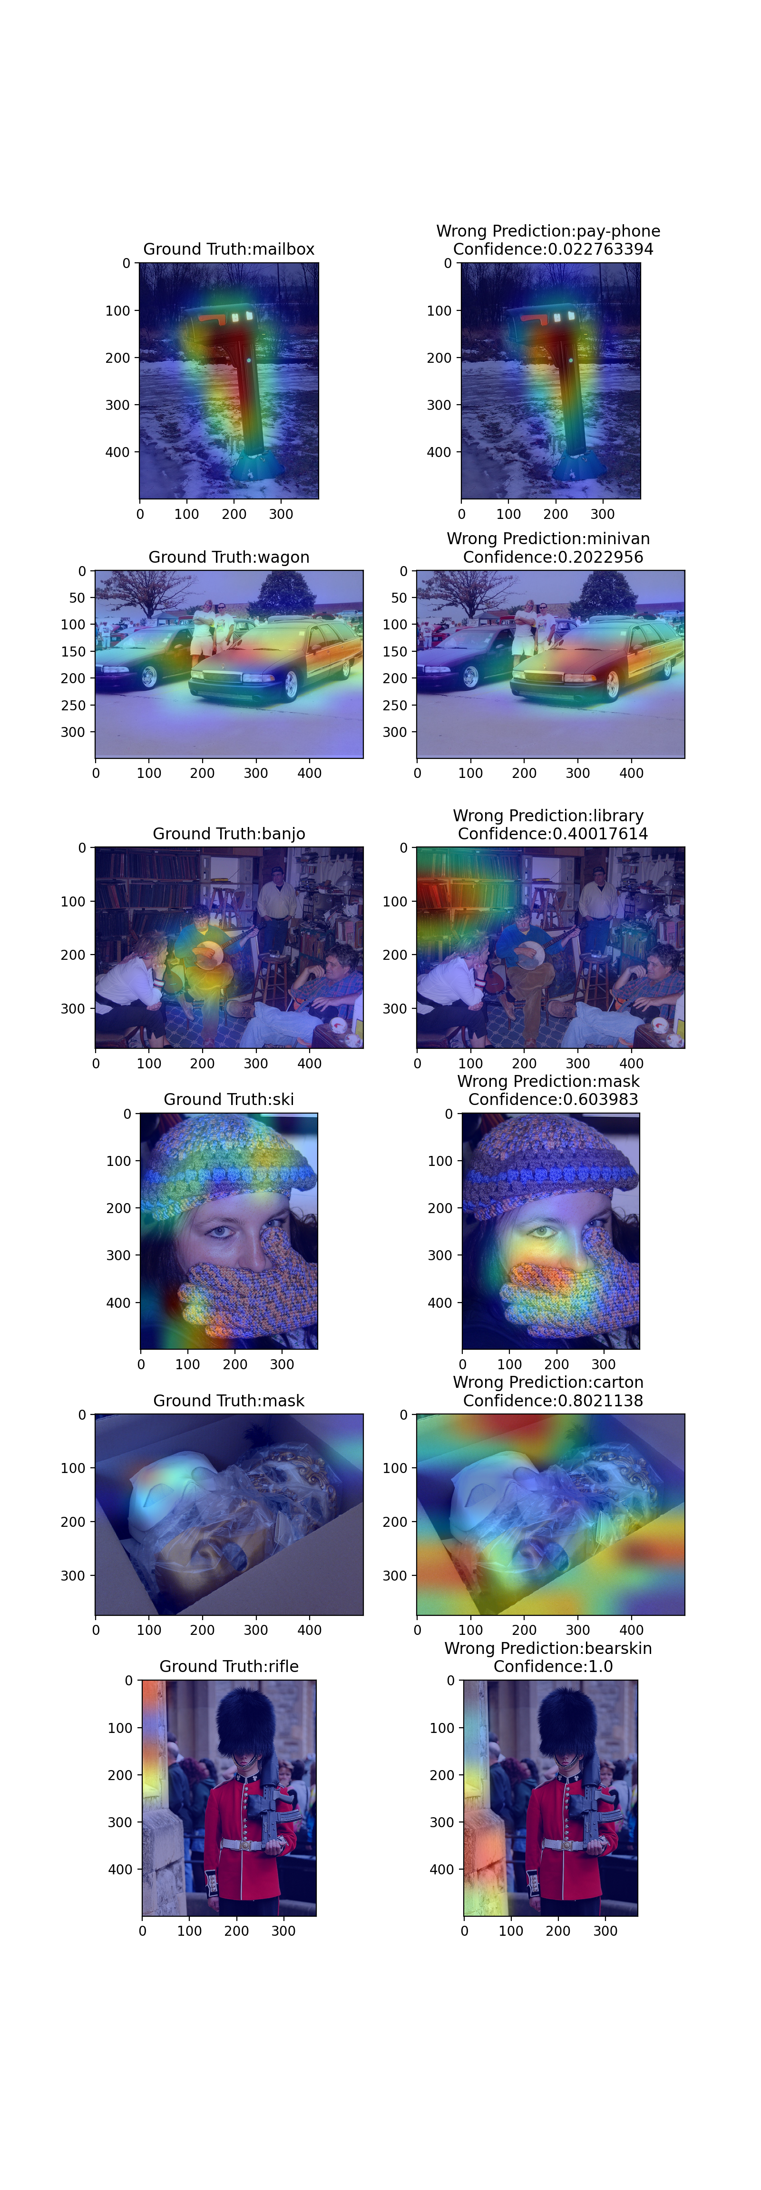
Analysis on Wrong Prediction

Slide 23
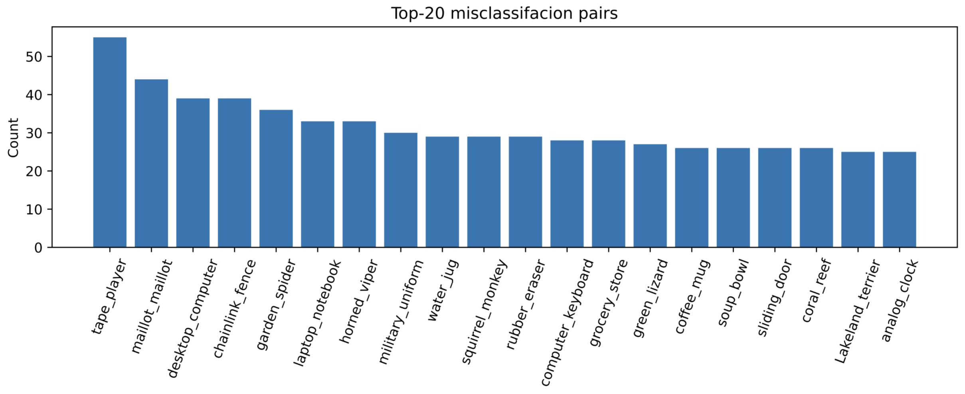
Analysis on Wrong Prediction
Most of wrong prediction are not caused by class co-occurrence,
But class-occurrence is an important reason of wrong prediction

Slide 24
Definition of types of error
- Type I Error, True GroundTruth Attention, Wrong Prediction Attention (Largest Proportion, at least 40% ~ 50%)
- Type II Error, Wrong GroundTruth Attention, True Prediction Attention (Mislabled issue, Few examples)
- Type III Error, Both GroundTruth Attention and Wrong Prediction Attention are True (Class Co-occurence, Second Largest Proportion, around 10% ~ 20%)
- Type IV Error, Both GroundTruth Attention and Wrong Prediction Attention are Wrong (Impossible to solve, Rare)
We should mainly Focus on Type I & Type III Error

Slide 25
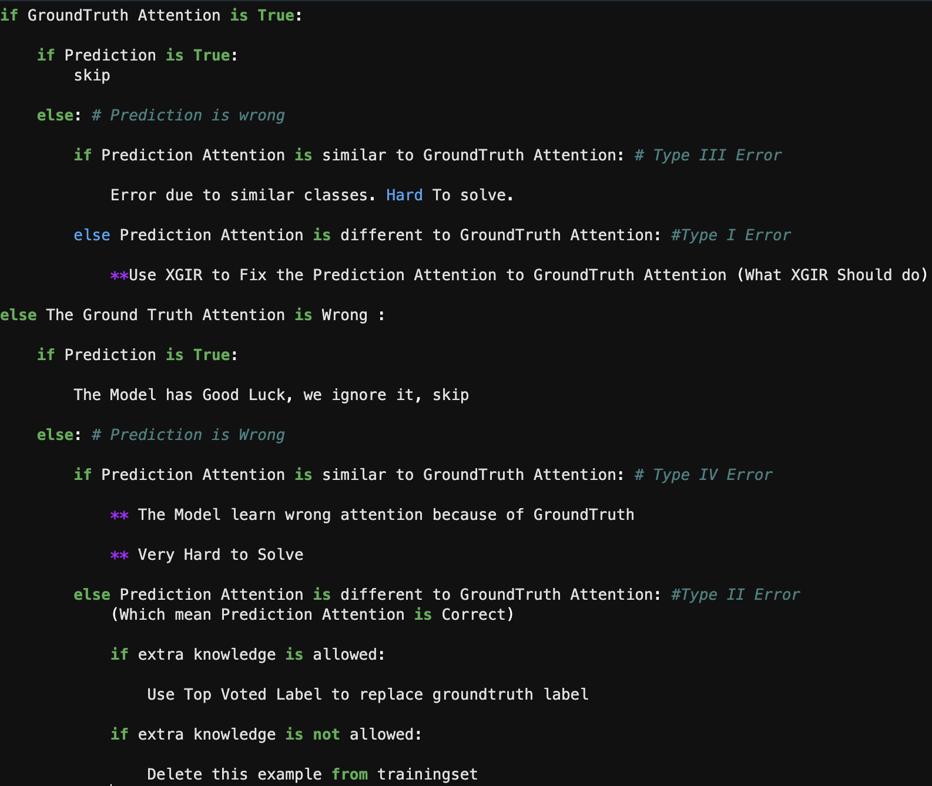
Idea of when to adopt XGIR, based on type of error

Slide 26
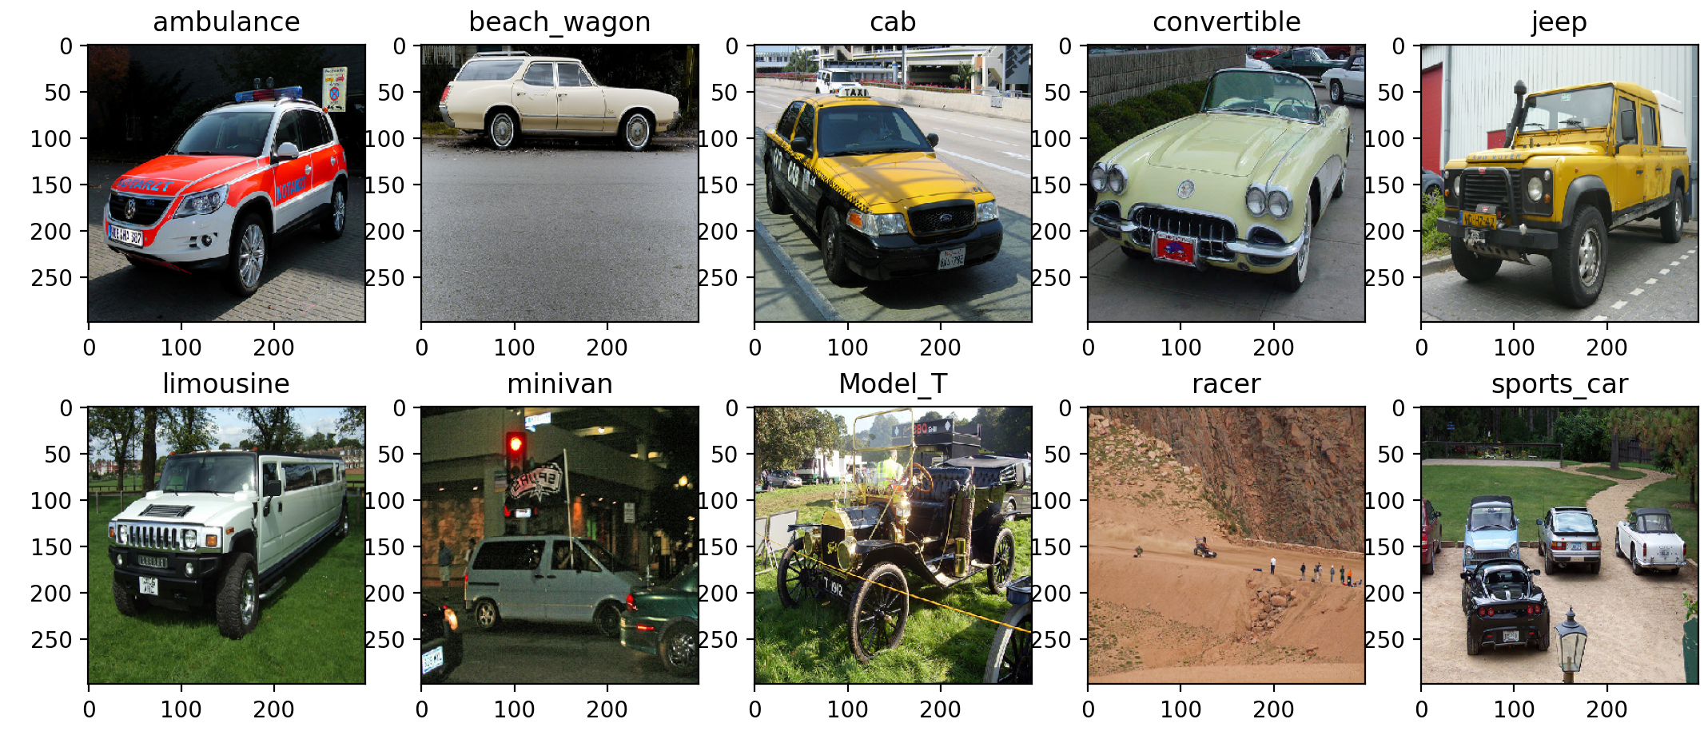
Superclass Classification
Make a super-class, C_car (union of all cars). # of car : # of non-car = 1: 99
Determine the important features for C_car
Determined by fine-tuned model: Take ResNet, remove the last layer, add a binary classifier, learn the W for the last layer in new model by fine-tuning while keep the backbone frozen.
Build a binary classifier for C_car using IR.
Set the weight for unimportant features to 0 for both classes

Slide 27
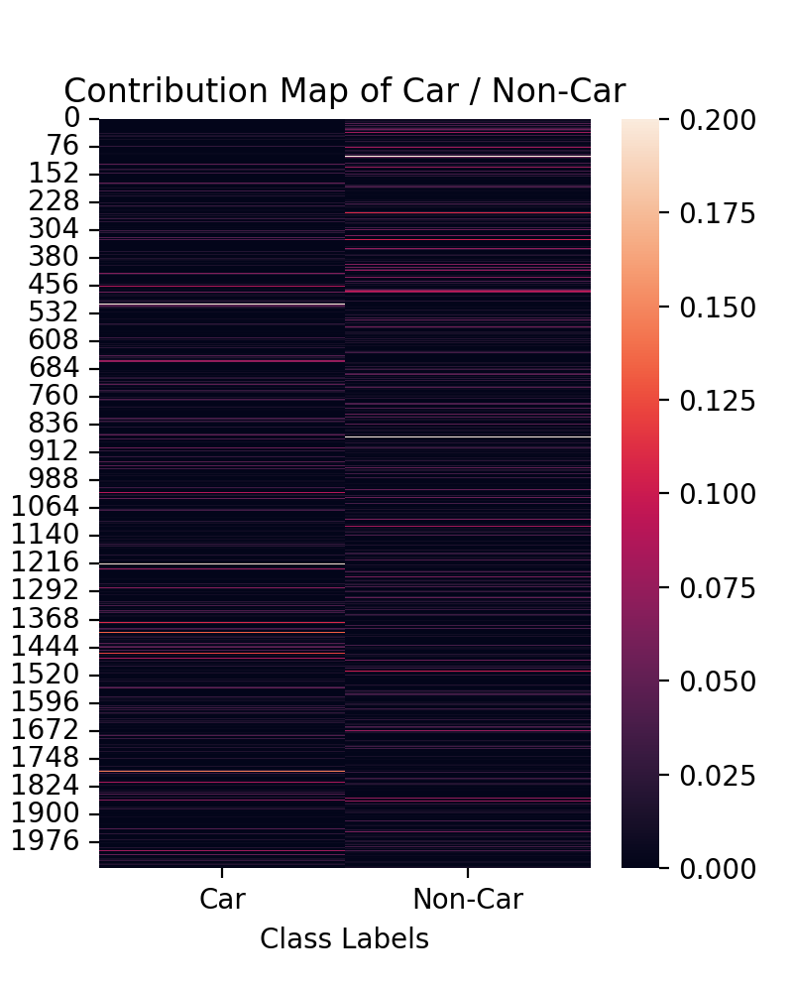
Visualization of Features Contribution of car/non-car

Slide 28
Superclass Classification - Result
Metric | Val | V2
Accuracy | 0.9801 | 0.9770
AUC | 0.9951 | 0.9943
Precision | 0.9801 | 0.9770
Recall | 0.9801 | 0.9770

Slide 29
Summary
A XAI-Guided two-stage training approach is adopted.
Experiment demonstrates that some feature units are more important
Several controlled experiments are done, show that:
- The approach can reduce the accuracy gap slightly
- The continued training leads to worse performance on imagenet-v2
Superclass classification is successful
- Important feature units of a group of labels can be identified

